Slide 1



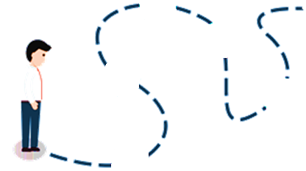





How to write a scientific paper?
Open Access vs. Subscription journals
www.agrimetsoft.com
https://youtube.com/AgriMetSoft/

Slide 2


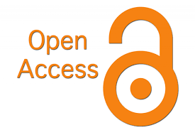








What is an “Open Access Journal”?
Open access (OA) is a set of principles that research outcomes are published online, free of access charges or other barriers.
2
Notes:
With the presence of the Internet, researchers no longer need access to hard copies of their desired journals to keep in touch with the most recent developments. The latest research is disseminated in many ways, including blogs, universities' websites, social media sites, and OA journals that are freely available to anyone with Internet access.

Slide 3



What is an “Open Access Journal”?
OA articles funded by payments for publishing made by:
Article
Publishing
Charges
(APCs)
Notes:
Open access articles funded by payments for publishing made by authors, their institution or funding bodies, commonly known as Article Publishing Charges (APCs).

Slide 4



What is a “Subscription Journal”?
Usually need readers to pay for the content that they read.
Those who have purchased a journal subscription and paid for an article will have access to your paper.
4

Slide 5




What is a “Subscription Journal”?
The author does not need to pay!
5
Notes:
university library's database subscriptions

Slide 6




Main differences
OA
Vs.
Sub.
6

Slide 7


1
2
Readers are not charged
Authors generally retain copyright.
Open Access
Copyrights for the published content are usually transferred to the journal.
Require readers to pay
Subscription
7
Notes:
Subscription-based journals typically require readers to pay for the content that they read.
Another difference is that in the subscription model, copyrights for the published content are usually transferred to the journal, while with open access journals authors generally retain copyright.
However, in the open access model, authors usually have to pay article-processing charges (APCs) once their paper has been accepted for publication.

Slide 8



Which one is better? OA or Sub.
Watch
the next video
OA types
How can select it?
How do I know if a journal is open access?

Slide 9





Please subscribe to our channel (https://youtube.com/AgriMetSoft/)
Like & do not forget to share it!!
Put your comments and questions below the video.
www.agrimetsoft.com
https://youtube.com/AgriMetSoft/
Notes:
Please hit the thumbs up button and don’t forget to subscribe !

